Slide 1

Guide Based High Key and
Low Key Prediction using a
Unified CNN Network

Slide 2
Problem Statement
• High key and low key are important artistic effects used to highlight
the main subject of interest under controlled studio light effects.
• It has many real-life applications in various fields such as photography,
cinematography, image editing ,Virtual reality and augmented realities.
• In general, High key and low key are tuned computationally by using a
segmentation mask generated from the CNN network.
• The idea is to develop an Unified CNN model that generates high
key and low key from input RGB image and an alpha channel guide
that is based on user choice.

Slide 3
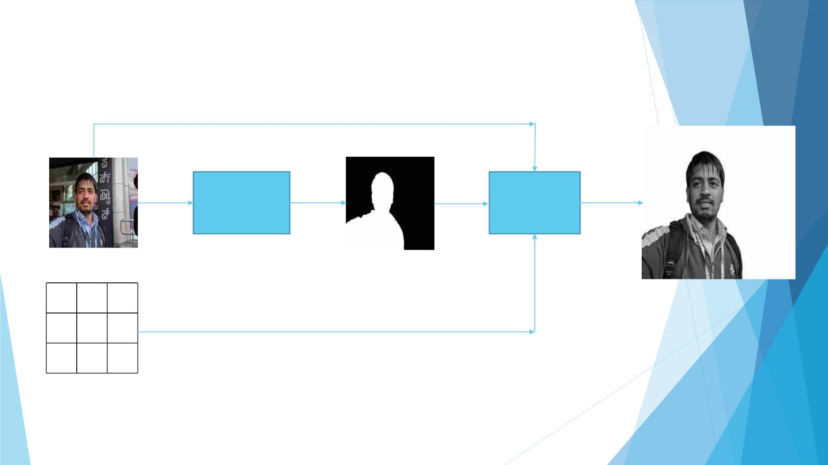
Methodology
Model 1
Model 2
U-Net
MobileNetV2
Input Image
Segmentation Mask
α α α
α α α
α α α
Output Image
Alpha Channel
Alpha channel (α) is 1 if High Key and 0 if low key

Slide 4
Methodology
• By generation of segmentation mask image of the input image:- It is a binary image
that identifies and labels different objects and regions in the input image.
• Segmentation mask will help the model to deeply understand the spatial
distribution of different regions and objects present in the input image.
• By using the labels provided by the segmentation mask, the model can selectively
apply the respective high key or low key lighting effects to specific regions.
• Segmentation Mask Generation Using MobileNetV2
• It is a light-weight efficient CNN model specifically designed for mobile devices, to
extract segmentation masks from input images .It can be easily deployed on
resource constrained mobile devices maintaining same performances.
• In this Depth-wise Separable Convolution is introduced which dramatically reduce
the complexity cost and model size of the network, which is suitable to Mobile
devices, or any devices with low computational power.

Slide 5
Methodology
• High Key Low Key generation Using U-net Architecture:-
• It is a popular image segmentation architecture . It consists of
encoder-decoder architecture.
• The encoder pathway consists of series of down-sampling operations
to capture the features from input images. It increases feature
channels while reducing spatial dimensions.
• The skip connections concatenate feature maps from encoder to
corresponding decoder.
• The decoder pathway consists of blocks of up-sampling to recover
spatial resolution of feature maps reserving the features.
• By experimenting with different hyper-parameters of the model, we
can improve the results accuracy.

Slide 6
Model Complexity
• Overall Model Complexity :-
Computational complexity: 2298.38 Gmac
Number of parameters:
5.23 M
• MobileNetV2 complexity :-
Computational complexity: 53.68 Gmac
Number of parameters:
3.61 M
• U-net Complexity
Computational complexity: 2244.7 Gmac
Number of parameters: 1.62 M

Slide 7

Experiments to Improve Model
◆ Model Reduction
Model2 complexity was very big. In order to reduce its complexity these
experiments on Hypermeters were done.
Experiments
Depth
32
Start_filts
Requires_Grad
False
1
2
3
4
5
6
7
8
4
3
5
2
4
3
5
2
64
False
16
False
128
32
False
True
64
True
16
True
128
True
The 8th Experiment gave the better results compared to other experiments.

Slide 8
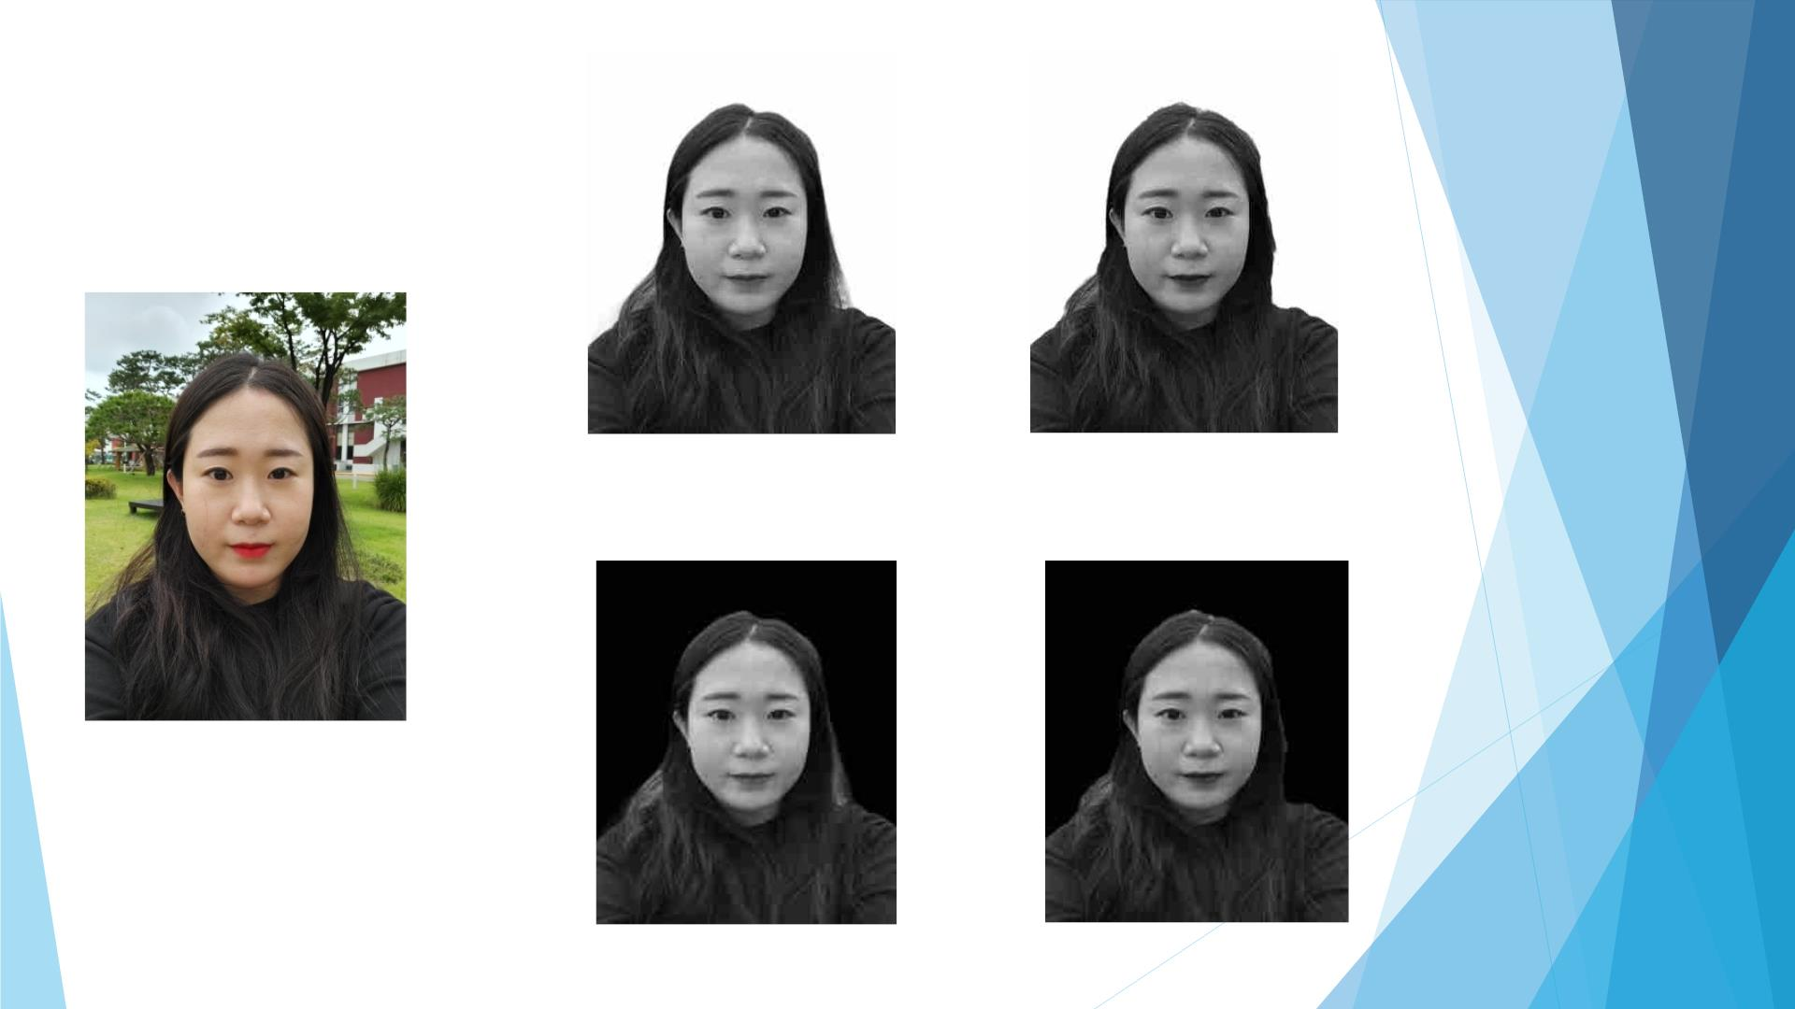
Good Results
Ground Truth High Key
Generated High Key
Input Image
Ground Truth Low Key
Generated Low Key

Slide 9
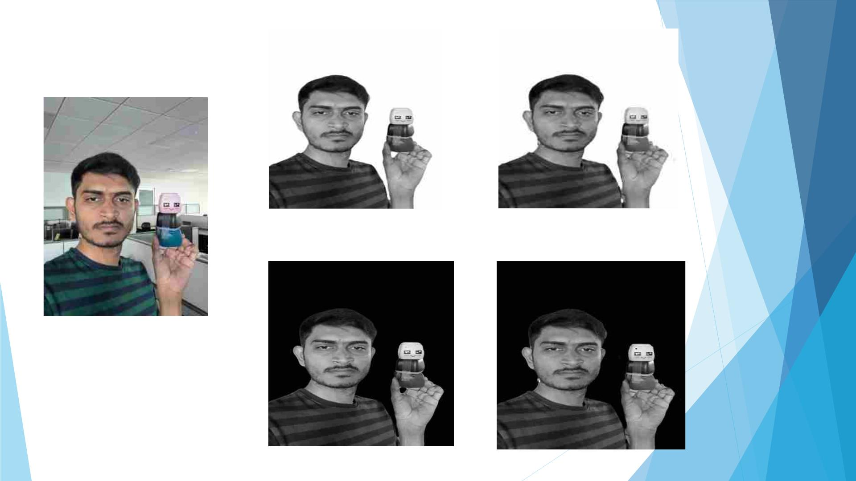
Good Results
Ground Truth High Key
Generated High Key
Input Image
Ground Truth Low Key
Generated Low Key

Slide 10
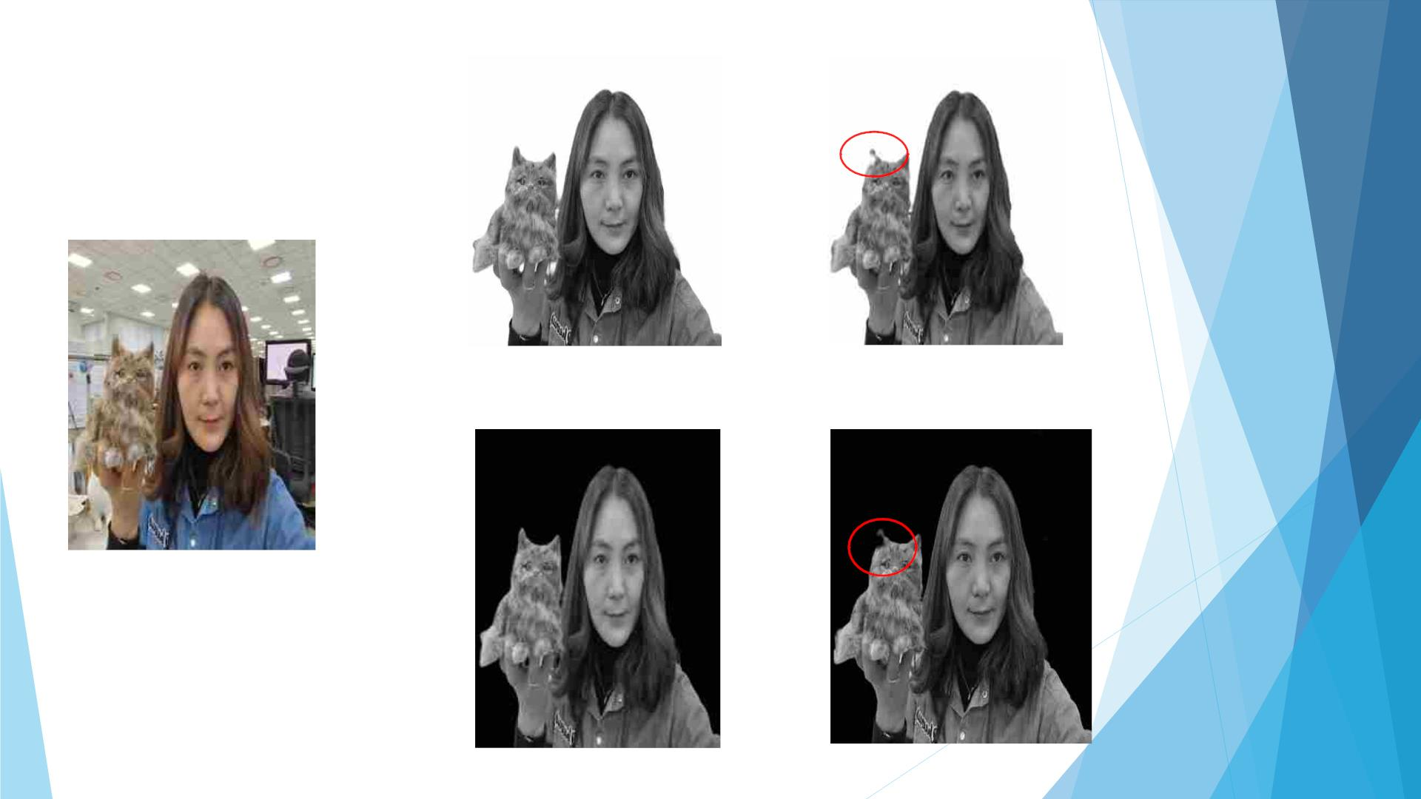
Good Results
Ground Truth High Key
Generated High Key
Input Image
Ground Truth Low Key
Generated Low Key

Slide 11
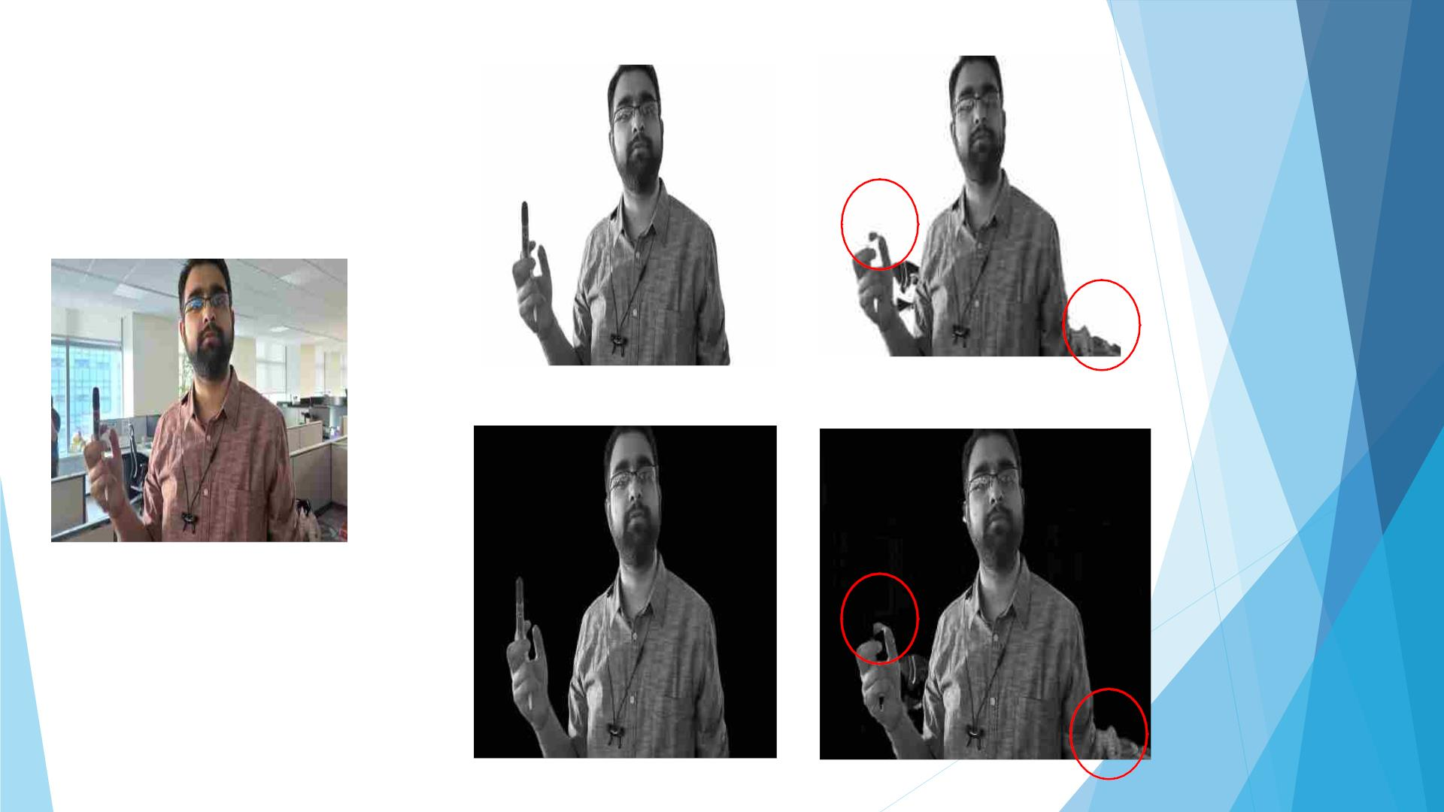
Bad Results
Ground Truth High Key
Generated High Key
Input Image
Ground Truth Low Key
Generated Low Key

Slide 12
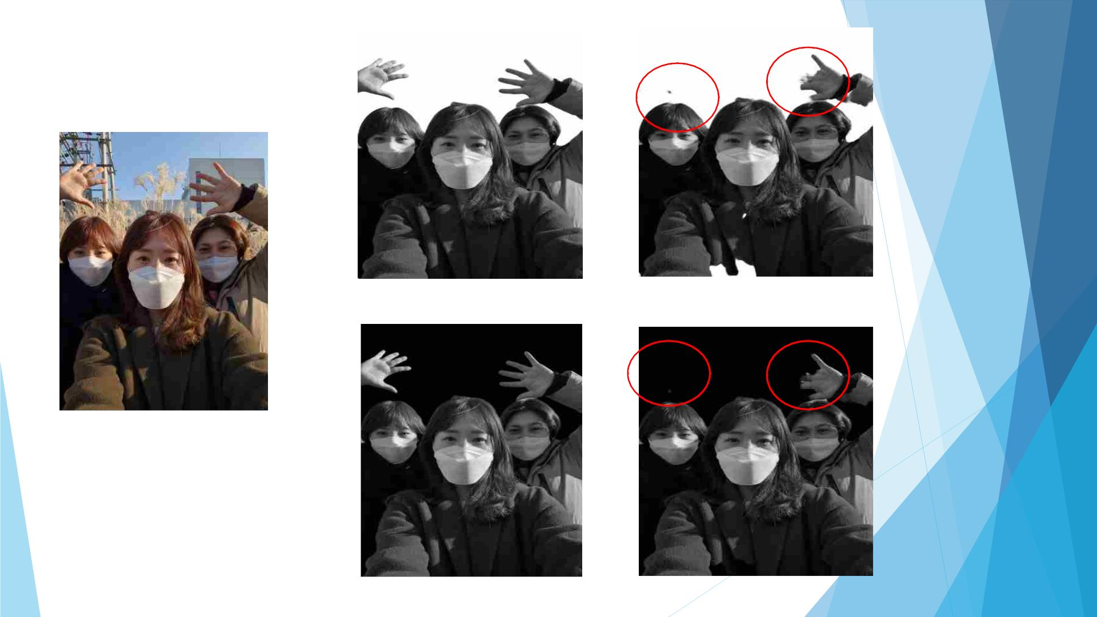
Bad Results
Ground Truth High Key
Generated High Key
Input Image
Ground Truth Low Key
Generated Low Key

Slide 13

Results Overview
◆ Mostly all results are positive and matching with the Ground truth,
except some of the images in which backgrounds are matching with the
person.
◆ In some of the results, background is also coming because of similarity
in the object and background.
◆ Also in some of them some parts of the object are missing because of
similarity in the parts of the object and background.

Slide 14
Future Works
◆ Overall Model Complexity Can be improved using different efficient models.
◆ By training on more data in training of the model.
◆ By making more experiments and optimizing the model to obtain better
results.
THANK YOU

